Slide 1
Management
PhD in Business Economics
Luis D. Torres, PhD.

Slide 2
Agenda
Part 1: Foundations of organisational change
Part 2: The micro-dynamics of change: Sensemaking
Part 3: Sustainability transitions: Systems and paradigms
Part 4: Power, politics, and future research

Slide 3

Foundations of organisational change

Slide 4
Foundations of organisational change
Organisational change refers to the actions in which a company or business alters a (major) component of its organisation, such as its culture, the underlying technologies or infrastructure it uses to operate, or its internal processes.
“change is about moving or shifting from one position to another”
Change management is the process of guiding organisational change to a successful resolution, and it typically includes three major phases: preparation, implementation, and follow-through.

Slide 5
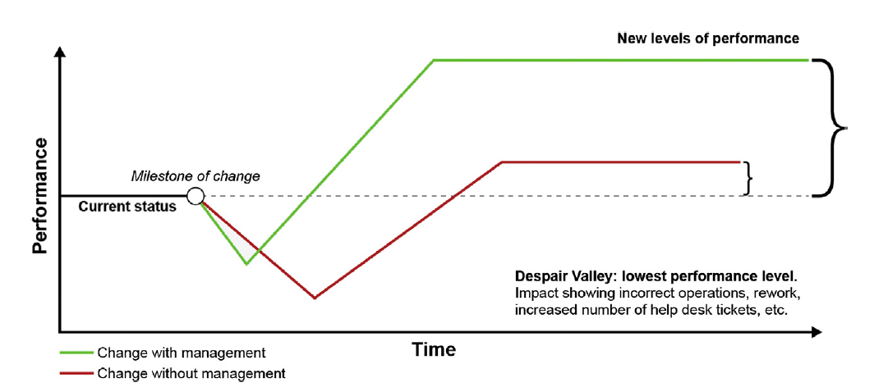
Foundations of organisational change
Source: Kübler-Ross, E. (1969) , On Death and Dying, Routledge, ISBN: 0-415-04015-9.

Slide 6
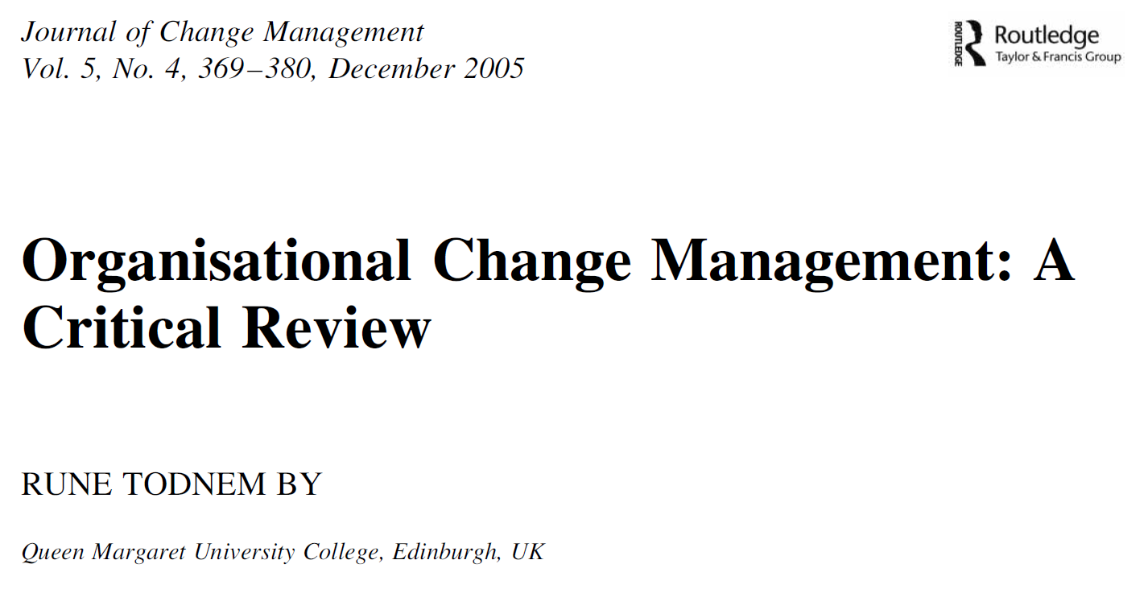
Foundations of organisational change
The 70% failure rate myth
Continuous vs discontinuous change
Planned vs emergent change
Scale of change: fine-tuning, incremental adjustment, modular transformation, and corporate transformation.

Slide 7
The what: Types of change
First order: Incremental change
Continuous change – evolution
Ongoing learning & flexibility
Gradual adjustment
Second order: Transformational change
Discontinuous change – revolution
Sudden break with the status quo
Stable & unstable periods alternate
Many changes will fall somewhere in the middle

Slide 8
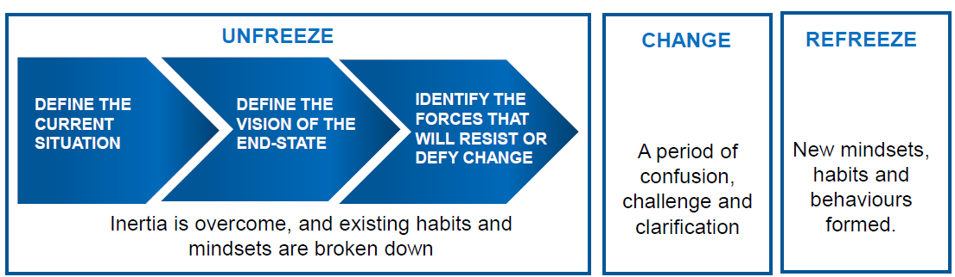
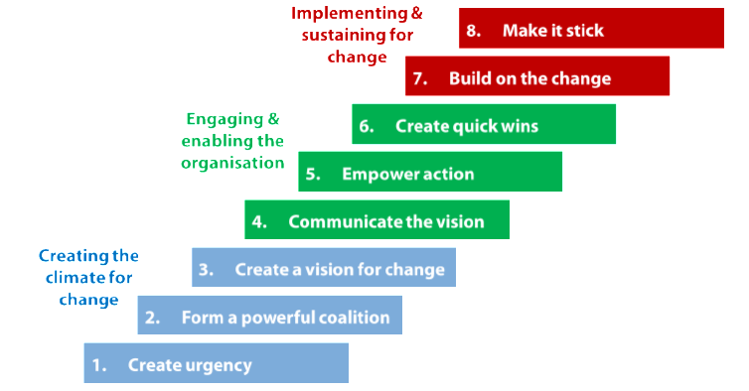
The How: The Process of Change
Typically, two juxtaposed conceptualizations that commonly depict how change is approached by organisations: from planned to emergent.
Some of the most known planned approach models are:
Lewin’s Change Model (Lewin, 1951)
Kotter’s Eight Steps of Change (Kotter, 1995)

Slide 9
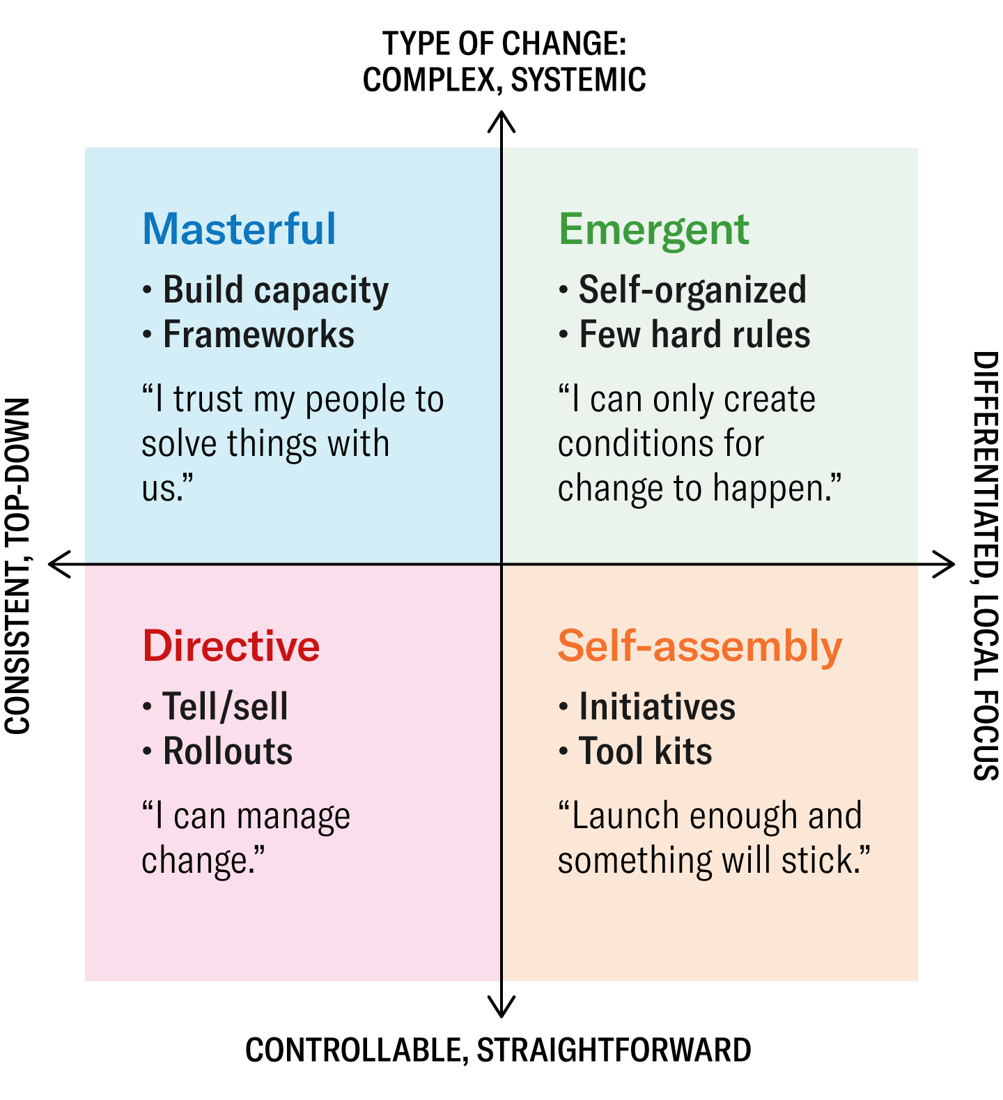
The How: The Process of Change
Accounting for the emergent nature of change:
Source: Rowland, D., Thorley, M., and Brauckmann, N. (2023). The Most Successful Approaches to Leading Organizational Change. Harvard Business Review. https://hbr.org/2023/04/the-most-successful-approaches-to-leading-organizational-change

Slide 10

The micro-dynamics of change: Sensemaking and the managerial paradox
We are wired to fear the unknown.
That “gut reaction” may not allow us to see a crucial fact: Uncertainty and possibility are two sides of the same coin.
Just like risk and opportunity
Think: Consider the achievements you are most proud of, the moments that transformed your life, the relationships that make your life worth living. Did they happen after a period of uncertainty?

Slide 11

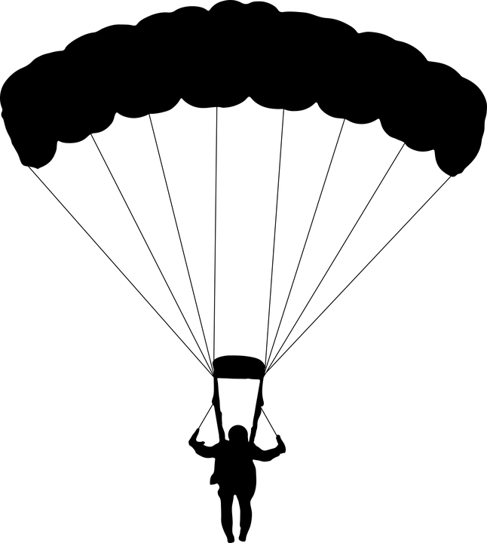

Managing change as a risk
What situation is “riskier” and why?
Jumping with a parachute
Jumping without a parachute

Slide 12
Managing change as a risk
Goal oriented approach to risk:
We assess risks according to our objectives.
We need to accept uncertainties in order to achieve our objectives
Let’s say the chances you have are:
You do alright = 80%
You survive, but with an injury = 19%
You die= 1%

Slide 13
The What: Types of change
Mitigating factors
(internal and external)
Risk source
Risk event
Impacts
Consequences
Risk factors
(internal and external)
Sometimes we assume the event will take place, so mitigating and risk factors move between the event and the impacts.

Slide 14
The What: Types of change
Mitigating factors
(internal and external)
?
?
Impacts
Consequences
Risk factors
(internal and external)
Resources (budgets, workloads, talent, systems).
Alignment (stakeholder commitment, governance, purpose of change unclear).
People (habit, fear, autonomy and power, dissatisfaction, culture)

Slide 15
The micro-dynamics of change: Sensemaking
Weick et al (2005) explain how circumstances are turned into words and how organising is talked into existence.
Sensemaking is the ongoing retrospective development of plausible images that rationalize what people are doing.
Organising is the continuous, ongoing process of sensemaking. Organising provides a set of shared meanings and rules that allow a group of people to coordinate their behaviour despite the inherent messiness of the world.
Four processes:
Ecological change: An unexpected event occurs in the environment that disturbs the current flow of action.
Enactment: People actively bracket certain cues from the mess of data around them. By noticing some things and ignoring others, they literally enact the environment they then have to deal with.
Selection: People apply labels and categories to these cues to reduce ambiguity (What is going on here?).
Retention: Successful interpretations are stored as mental maps or recipes for future action.
A fundamental tenet of Weick’s view is that organizing is retrospective. He argues that people can only know what they are doing after they have done it.

Slide 16
The micro-dynamics of change: Sensemaking
Sensemaking theory provides the framework to understand why change fails/succeed.
Lüscher & Lewis (2008) apply the sensemaking framework to explain the paradoxes managers faced during a major change at LEGO.
Three paradoxes identified at Lego: Performing (people vs. production), Belonging (individual vs. collective), and Organising (stability vs. change)
Three stages:
The mess: Initial confusion, frustration, and feeling stuck.
The problem: Identifying the specific paradox (e.g., "I need to be a boss and a coach at the same time").
Workable Certainty: Accepting that the contradiction is inherent. Instead of choosing one side, they found ways to live with both (e.g., "I will coach my team so that they can hit the production targets").

Slide 17
Sustainability transitions: Systems and paradigms
Sustainability transitions shifts from the internal management of a single firm to how entire societal systems (energy, food, mobility) change over decades.
Biely & Chakori (2024) argue that sustainability is not a single goal but is viewed through two "incommensurable" (unmixable) paradigms:
Technocentric Paradigm (Weak Sustainability): Focuses on "Green Growth." It assumes that technological innovation (e.g., electric cars, carbon capture) can solve environmental issues without changing the underlying capitalist economic structure.
Ecocentric Paradigm (Strong Sustainability): Argues that the economy is a subsystem of the environment. It focuses on "Post-Growth" or "Degrowth," suggesting that we must reduce absolute consumption and stay within planetary boundaries.

Slide 18
Power, politics, and future research
Political and social struggles involved in shifting entire global systems.
Köhler et al. (2019) proposes that transitions are not just about better technology winning, but about deep political contests.
Sustainability transitions are normative, meaning they are driven by values and goals (like stopping climate change) rather than just market efficiency. This raises critical ethical questions:
Just transitions: As we move to new systems, who gets left behind? Research focuses on ensuring that workers in declining industries (like coal mining) and vulnerable populations are protected.
Energy and social justice: Transitions must address inequalities in how resources, costs, and benefits are distributed across society.
Future research agenda must look beyond just firms and government:
Civil society: What is the role of social movements and non-profits in demanding and creating change?
Geography and space: Transitions happen differently in a city in the Global South versus a rural area in Europe.

Slide 19
Conclusions
Change fails when leadership treats it as a discontinuous event rather than an ongoing process of sensemaking where reality is talked into existence.
Moving to the macro-scale, we observed that the same cognitive lock-ins seen in managers are mirrored in global scientific and policy circles.
The system incommensurability between technocentric (growth-oriented) and ecocentric (limit-oriented) worldviews explains why transitions often stagnate.
The Future Research Agenda therefore requires a shift from viewing transitions as purely technical shifts to viewing them as normative, value-driven struggles for a just and sustainable future.

